Slide 1
Detecting Cognitive States
from Degraded EEG Signals
EEG Signal Processing
DEAP Dataset
Asritha Madadi
MSDS696_S71_Data Science Practicum 2
Regis University

Slide 2
Why EEG Emotion Detection Matters
The Noise Challenge: EEG corrupted by muscle noise, signal drift & electrode failure,
So Robustness to degraded signals is rarely tested.
Brain-Computer Interfaces (BCI): Translates brain signals into computer commands, Used in medical devices, gaming & assistive tech.
EEG is the Gold Standard: Non-invasive, portable & affordable (~$300)
Captures millisecond-level brain dynamics.

Slide 3
Research Question
Can EEG signals reliably detect cognitive states even when the signal is noisy, incomplete, or corrupted?
My Approach
Build & train 6 models on clean and degraded EEG signals.
Combine into a weighted ensemble .
Test robustness under 4 real-world noise conditions.

Slide 4
DEAP Dataset
DEAP Dataset by Queen Mary University of London
32 participants watched 40 1-minute videos, EEG recorded at 128 Hz.
32 subjects, 40 trials, 32 channels --> windowed into 38,400 segments
Arousal + Valence scores mapped to 4 states: Positive, Stressed, Fatigued, Calm.
Russell's Circumplex Model
It's a psychological model that maps emotions onto two dimensions - arousal and valence.

Slide 5
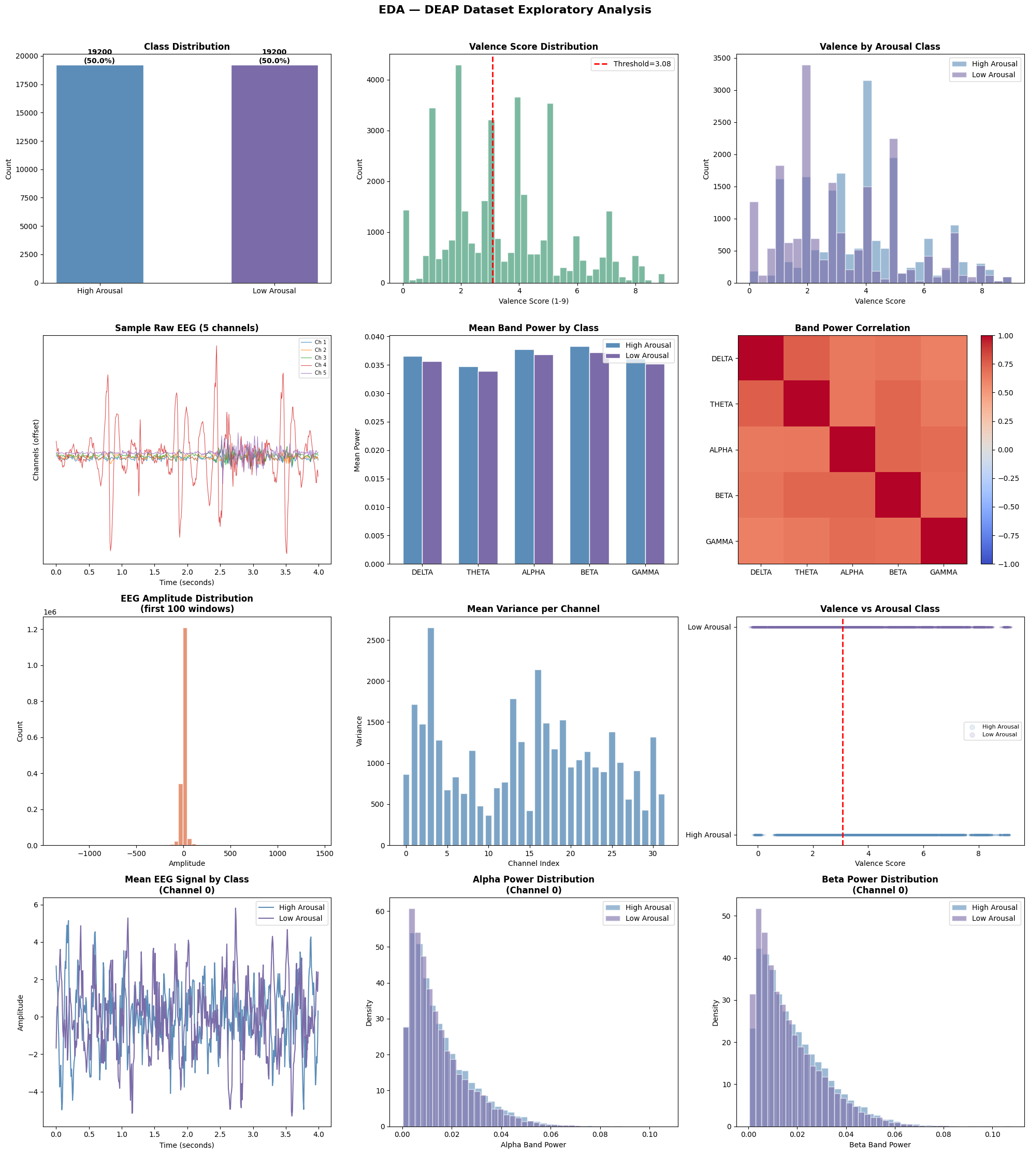
High Arousal consistently shows higher power across all 5 frequency bands & Beta band shows the largest gap - known to be linked to active mental states.
This visible separation between classes is exactly why band power was chosen as the feature for ML Models.
Perfectly balanced - 19,200 windows per class, no bias in training.Equal split ensures the model learns both arousal states equally well.

Slide 6
Deap Dataset
32 subjects . 40 trials . 128 Hz
Preprocessing
Bandpass 1-45 Hz . Z-score norm
Windowing
4s . 50% overlap --> 38,400 windows
Architecture
Feature Extraction
Band power . Matrix . Raw EEG
SVM
CNN
Random Forest
LSTM
Weighted
LDA
CNN-LSTM
Cognitive State Output
Positive . Stressed . Fatigued . Calm
Robustness Testing . 4 Degradation Condition

Slide 7
MODEL ARCHITECTURES
SVM RF LDA
Structure Kernel-based hyperplane decision trees Linear projection
Input 160-dim band power 160-dim band power 160-dim band power
CNN LSTM CNN-LSTM Hybrid
Type Spatial pattern learning Temporal sequence model Dual-stream fusion
Input 32*10* 1 32*512 combines both
Parameters 470,402 140,418 330,882
Batch Size 64 64 64
Epochs 60 50 60
Early Stop 12 12 12
Optimizer Adam Adam Adam
Layers 16 7 19

Slide 8
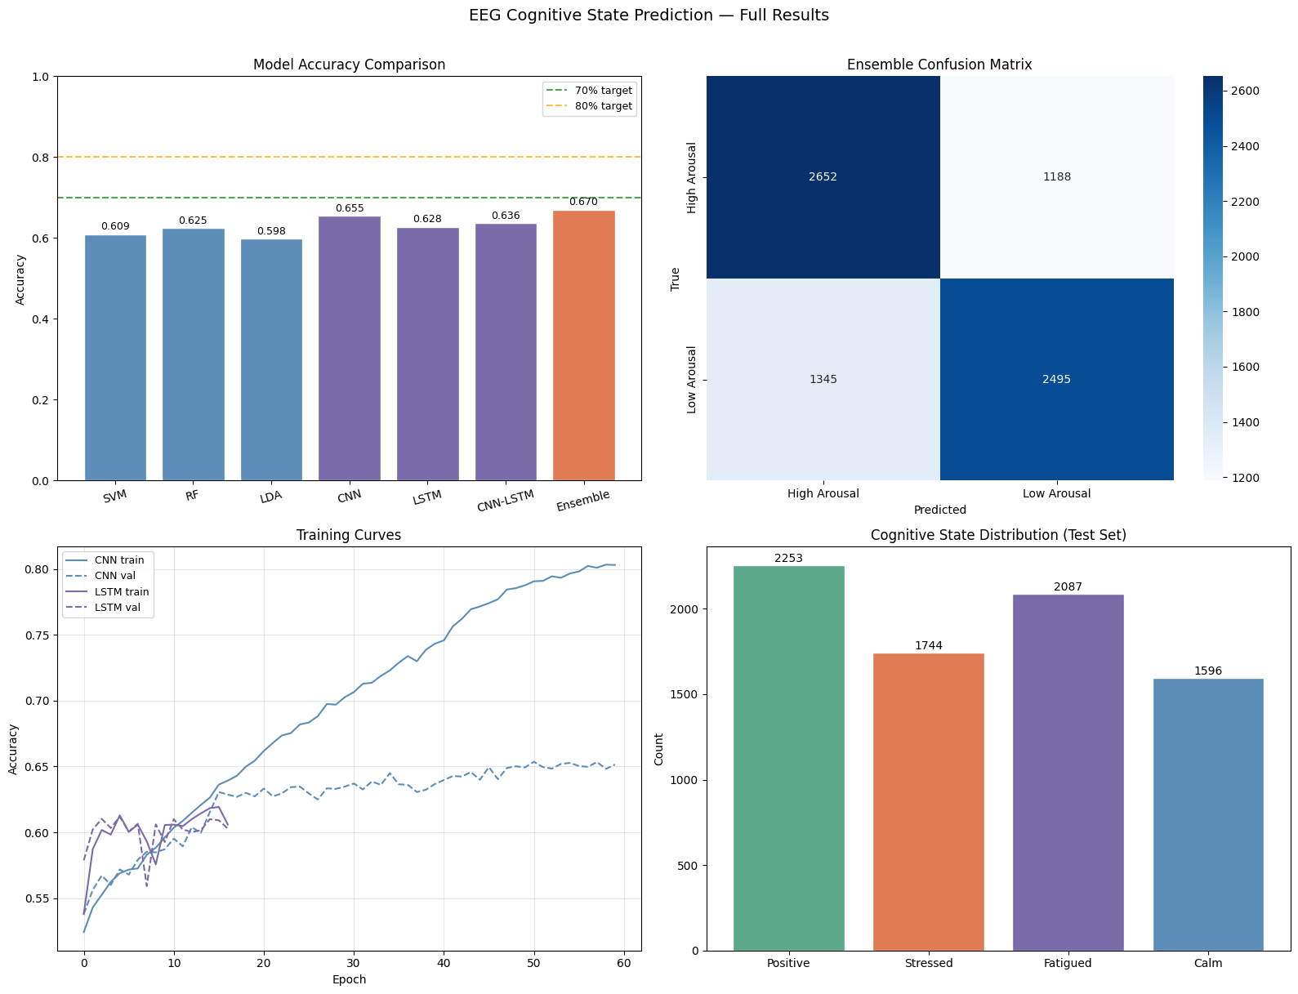
Data Visualizations
CNN outperforms all classical models -65.5% vs SVM 60.9%, RF 62.5%, LDA 59.8%
Weighted Ensemble of all 7 models achieves the best result at 67.0%
Dropout, EarlyStopping, and class weighting used to control overfitting
LSTM converges faster but peaks earlier - CNN learns complex spatial features

Slide 9
Data Visualizations
Model correctly identifies High Arousal better (2,652) than Low Arousal (2,495)
High Arousal -excited or alert.Low Arousal - the brain is less active.
Positive (29.3%) is the most predicted state, Calm (20.8%) the least.
All 4 states are meaningfully represented - model doesn't collapse to predicting one class repeatedly, which means the circumplex mapping is working.

Slide 10
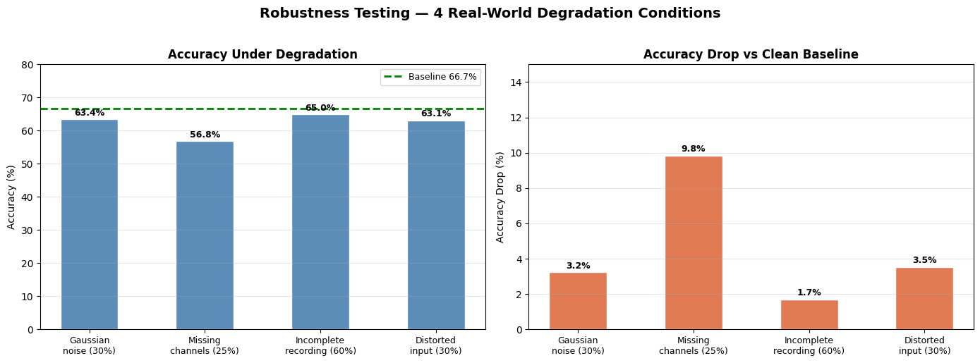
Gaussian noise( 30%) 63.4 % accuracy under 3 of 4 degradation conditions .
Missing channels (25%) caused the biggest drop - 56.8% accuracy, 9.8% drop - losing electrode
Incomplete recording (60%) was most robust - only 1.7% drop, model handles truncated signals well
Distorted input (30%) 63.1% accuracy, only 3.5% drop — model handles feature corruption well

Slide 11
Conclusion
Weighted Ensemble of 7 models achieved best accuracy of 67.0%
CNN outperformed all classical models - deep learning captures EEG patterns better
System stayed robust under noise and degraded signals
Successfully mapped EEG signals to 4 cognitive states: Positive, Stressed, Fatigued, Calm
Future Work
Real-time EEG prediction pipeline
Multi-dataset generalization testing
Extend to full emotion prediction beyond binary arousal

